Slide 1
Advance Java
JSP Implicit Objects and Forms
LEVEL – PRACTITIONER

Slide 2
About the Author
Created By: | Renjith(t-renjith)/ Shanmu (105110)
Credential Information: | Trainer / Sr Architect
Version and Date: | 1.0, January 12’th 2012
Cognizant Certified Official Curriculum
Notes:
For tde animators:
tdis screen content needs to be rendered in tde flash, no animations needed.

Slide 3









Icons Used
Hands on Exercise
Questions
Tools
Coding Standards
Test Your Understanding
Case Study
Best Practices & Industry Standards
Demonstration
Workshop

Slide 4
Objectives
After completing this chapter you will be able to understand:
What are JSP implicit objects?
How to handle form using JSP?

Slide 5
What are implicit objects?
Implicit objects in JSP are the objects that are created by the web container automatically and the container makes them available to the JSP to access it.
Implicit objects are available only inside the _jspService() method hence cannot be accessed anywhere outside.

Slide 6
List of Implicit Objects
Object | Class | Description
request | javax.servlet.ServletRequest | Reference to the current request
response | javax.servlet.ServletResponse | HttpServlet response object for the current request.
session | javax.servlet.http.HttpSession | Session associated with the current request
application | javax.servlet.ServletContext | Servlet context to which a page belongs
page | java.lang.Object | An instance of the JSP page's servlet class that processes the current request.

Slide 7
List of Implicit Objects
Object | Class | Description
pagecontext | javax.servlet.jsp.PageContext | Object to access request, response, session and application associated with a page.
out | javax.servlet.jsp.JspWriter | Object that writes to the response output stream.
config | javax.servlet.ServletConfig | Servlet configuration for the page.
exception | java.lang.Throwable | This objects is available in JSP pages where the page directive isErrorpage is set as true stating that it is an error page for some other JSP page. The error message can be displayed from this object.

Slide 8
Processing Values in Servlet Context
Values can be stored in the servlet context for making it available for all servlets in the application by setting it as an attribute to the JSP implicit object named application .
application.setAttribute(“visitorCount“,count) - Sets attribute to the application context.
application.getAttribute(“visitorCount") - Reads attribute from the application context.
application.removeAttribute(“visitorCount") - Removes attribute from the application context.

Slide 9
Handling Request and Response Object
JSP provides both request and response as implicit objects . All the HttpServletRequest and HttpServletResponse methods can be called on these objects
Example :
request.getParameter(“name”) ;
response.sendRedirect(“home.jsp”);
We will learn more on using these objects during lend a hand session.

Slide 10
Form Processing JSP
Rendering Forms :
Forms can be rendered as normal HTML forms inside JSP pages.
Forms can also be created dynamically by printing using the out.print() method if required.
Example:
<%
out.print(“<form>”);
out.print(“<input type=‘text’ name=‘userName’/>”);
out.print(“</form>”);
%>

Slide 11
Form Processing JSP
Handling Forms Actions :
Form actions can be handled by the same JSP or another servlet/JSP.
Example: When user clicks the login button in Login.jsp it can be handled by Login.jsp or HomePage.jsp or LoginValidator.java (Servlet)
If the same JSP is handling the form action then the form action attribute need not be specified.
Example: <form name=“LoginForm” method=“get”> // No action attribute specified.

Slide 12
Lend a Hand – JSP form Processing
In this demo we familiarize how forms can be developed and handled using JSP.
Here the form action will be handled by the same JSP itself.
JSP’s to be developed
login.jsp – Page which captures user name, password for login. The same page should be designed to process the login request and validated.
If user name is “tom” and password is “jerry” the login is considered successful.
success.jsp – In case of success the control should be redirected to the success page.

Slide 13
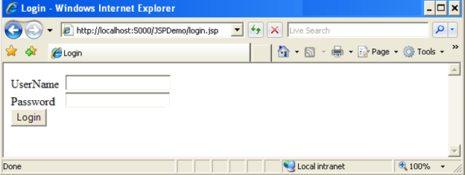
Lend a Hand – Login Page design.
Create a login page as shown in the screen shot below The page should have the following components
User Name – Text box
Password – Password field
Login – Submit Button

Slide 14
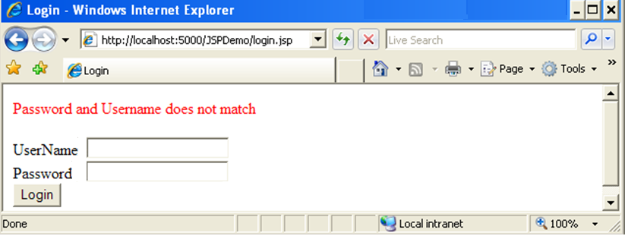
Lend a Hand – Invalid Login Page Design
In case of invalid login the output should be as shown .

Slide 15
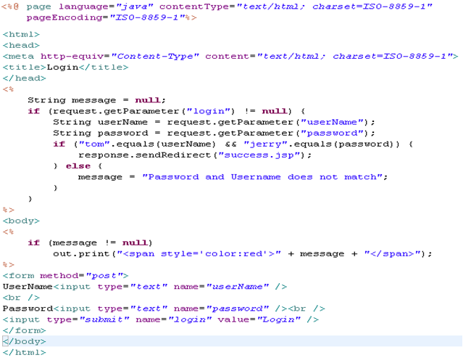
Lend a Hand – login.jsp code
Performs the form processing as below,
If the request parameter value for the submit button is not null it means form is submitted else the form is accessed using URL.
The other parameter values are read using the get parameter method validate user name and password as mentioned.
Prints the error message

Slide 16
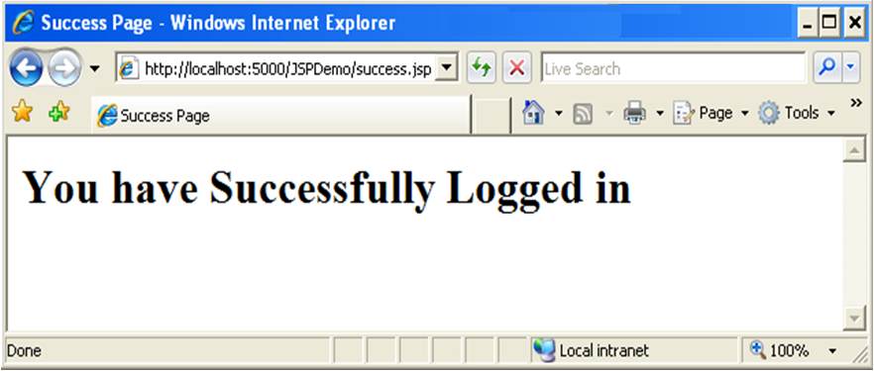
Lend a hand – Success page design
In case of successful login the control to be redirected to success page which should display a message as illustrated below.

Slide 17
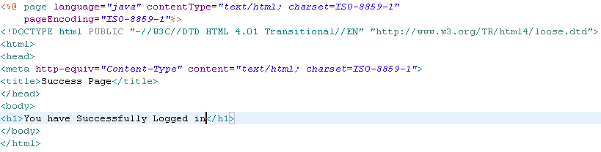
Lend a Hand – success.jsp
Develop success page as illustrated below

Slide 18
Lend a Hand - Deploy and Run
Step 1 : Deploy and run the application
Step 2 : Invoke login.jsp from the browser
http://localhost:5000/JSPDemo/login.jsp
Step 3 : Enter tom as username and jerry as password
You will be redirected to the success page
Step 4 : Invoke login.jsp from the browser . Enter incorrect username and password.
You will see the invalid login error message printed.

Slide 19
Hands on – Registration Application
Associates should develop the following hands on with the guidance of trainers
A registration application should be implemented based on the requirement depicted below,
The user invokes registration page from the browser – registration page rendered to the user.
User fills the registration form and submits the form – If all fields are not null the entered details should be displayed in a details page in a tabular form with name and value as the column headers.
User enters null value to any of the fields – The user is redirected to the same registration page with the appropriate error message printed.

Slide 20
Hands on – Registration Application
The following JSP pages needs to be developed,
Registration.jsp – Page which captures registration details.
Details.jsp – This will process the request from registration.jsp , if any of the mandatory values is null the control should be redirected to the registration page. If the entered details are proper display the details entered in a tabular format.
Error Message Format: “Password cannot be null”
Hints :
Make details.jsp the action page of registration form.
To pass the error message from details.jsp to registration.jsp set it as query string parameter to the URL
Example :response.sendRedirect(“registration.jsp?message=‘User Name , Password cannot be null’ ”);

Slide 21
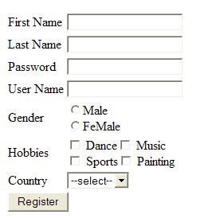
Hands on – Registration Page Fields
Create an Email Registration form using JSP with the following fields. The ones with the * marks are mandatory fields to be validated.
First Name * : Text Box
Last Name * : Text Box
Password * : Password Field
Gender * : Radio Button
Hobbies : Check Box
Values: Music ,Dance , Sports , Painting
Country : Combo box
Register - Submit button

Slide 22
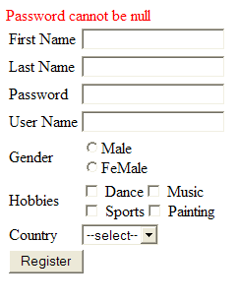
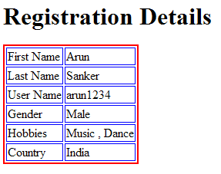
Hands on – Details and Error page design
Error Page
Details Page

Slide 23
Session Handling in JSP
The session management techniques used in servlets are also applicable to handle session in JSP also.
The following are the techniques used to manage session in JSP
URL rewriting
Hidden Field
Cookie
Session Object
Since all the techniques are covered in detail in servlets , here we will be discussing only about how to use the JSP implicit session object to manage session.

Slide 24
Handling Session with implicit Session Object
In JSP the HttpSession object named session is automatically created by the container and passed to the service method for use.
By setting attributes to the implicit session object , session can be managed across pages in JSP.
session.setAttribute(attributeName,value) :- Sets attribute to session
session.getAttribute(attributeName) :- Reads the attribute value
session.removeAttribute(attributeName) : Removes attribute from the session.

Slide 25
Lend a Hand – Using implicit session Object
This is a demo to showcase how session can be used in a JSP application by using the JSP implicit session object.
Scenario: In a web based mail application user logins with his user name and password. The subsequent pages inbox/Sent items he visits after login should have a welcome message with his username printed. We will see how this can be achieved using session objects.
Components to be Developed:
login.jsp : Login page, on successful login the inbox page to be displayed. If user name and password does not match “tom” & “jerry” redirect the control to the same login.jsp with the error message displayed.
inbox.jsp: The inbox of the user, should have a link pointing to sent items.
sent items.jsp : The sent items page for the user, should have a link pointing to inbox.
logout.jsp : The page which performs user logout by invalidating session
NOTE: The user name & location as part of the Login.jsp request should be available when the inbox and sent items JSP’s are accessed from the links mentioned in point # 1,2,3.

Slide 26
Lend a Hand – Login Page Design
Create login page as shown

Slide 27
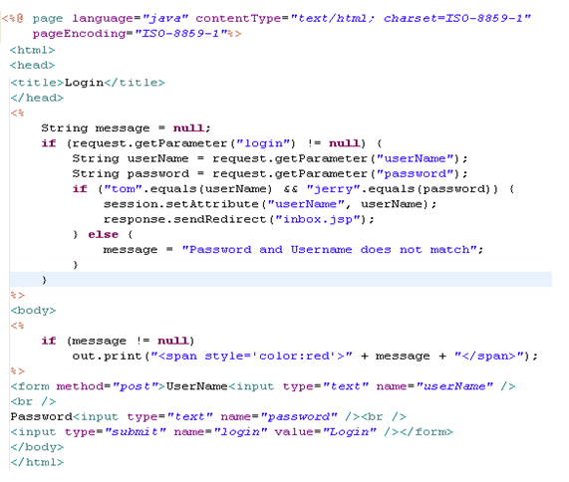
Lend a Hand – Develop Login Page
Performs the form processing as below,
If the request parameter value for the submit button is not null it means form is submitted else the form is accessed using URL.
The other parameter values are read using the get parameter method validate user name and password as mentioned.
On successful login the user name is set in session and redirected to inbox.jsp.

Slide 28
Lend a Hand – Invalid login Error Message
In case of invalid login the output should be as shown .

Slide 29
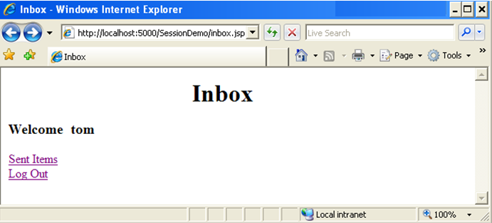
Lend a Hand – Inbox page
Create inbox page as illustrated below.
The welcome message to be displayed as below.

Slide 30
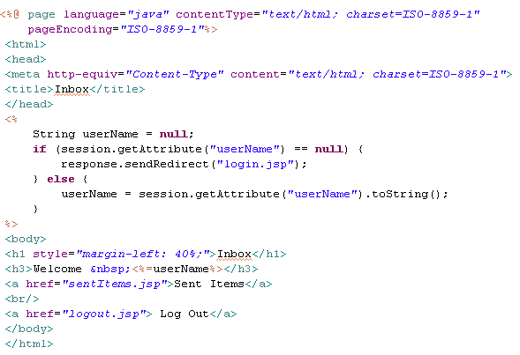
Lend a Hand – Develop inbox page
If user name is not set redirect to login page.
If user name is correct print the welcome message and display the sent item and logout link

Slide 31
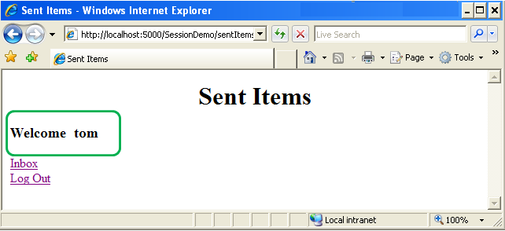
Lend a Hand – Develop Sent Items Page
Create sent items page as illustrated below.
The welcome message to be displayed as below.

Slide 32
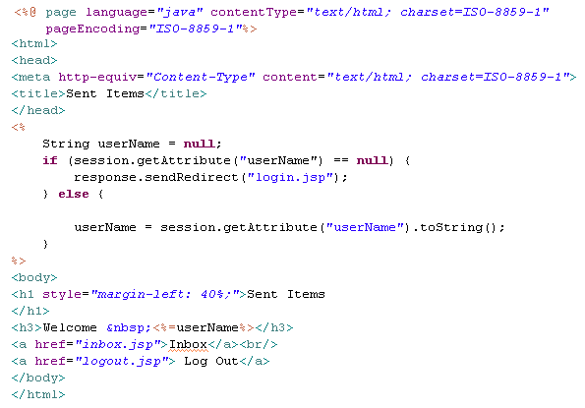
Lend a Hand – Develop Sent Items Page
If user name is not set redirect to login page.
If user name is correct print the welcome message and display the inbox and logout link

Slide 33
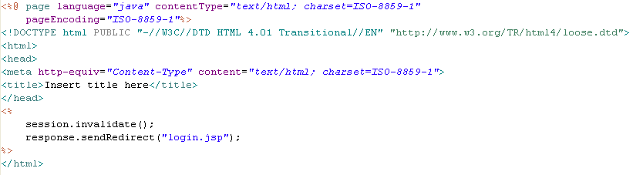
Lend a Hand – Develop logout.jsp
On clicking logout links from “inbox” or “Sent Items” page the session is to be invalidated.

Slide 34

Time To Reflect
Associates to quickly summarize the following before ending the session
What are the JSP implicit objects
What is the implicit object used for processing the user inputs?
What is the implicit object used for maintaining the state of an user?
What is the implicit object used for sharing data across the application?

Slide 35
Advance Java
You have successfully completed –
JSP Implicit Objects

